Slide 1
Technical assistance and capacity building in trade-in-services statistics
Onno Hoffmeister

Slide 2




Factors of the ITS production system
Onno Hoffmeister, Technical assistance and capacity building trade in services statistics
International statistical system
UNSD
Global trade data
Compilation skills
FAO
OECD
Concepts, definitions
UNCTAD
…
WTO
ITC
National trade data
Technical infrastructure
Institutional framework
NSO
NSO
…
Customs
Central Bank
…
MinTrade
…
Customs
…
…
National statistical system, country A
NSS, country B
NSS, country C
Workshop on Integrated Use of International Trade Statistics and Economic Statistics, 23 Nov 2021

Slide 3
Two initiatives to enhance statistical capacities
Onno Hoffmeister, Technical assistance and capacity building trade in services statistics
STIS capacity building for UEMOA member states
ITS e-learning all around the world
Workshop on Integrated Use of International Trade Statistics and Economic Statistics, 23 Nov 2021

Slide 4
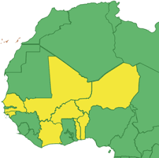
STIS capacity building for UEMOA member states
Onno Hoffmeister, Technical assistance and capacity building trade in services statistics
Workshop on Integrated Use of International Trade Statistics and Economic Statistics, 23 Nov 2021

Slide 5
Technical assistance project
Onno Hoffmeister, Technical assistance and capacity building trade in services statistics
Partner: Centre Statistique de l’UEMOA
Goal: Enhance the quality and harmonization of trade-in-services statistics in UEMOA member states
Outcomes:
Enhanced data availability (incl. bilateral flows)
Harmonization
Consistency with MSITS 2010
Deliverables:
Harmonized questionnaire
Support in survey design and implementation
Recommendations for imputation and estimation
Formation of knowledge
Workshop on Integrated Use of International Trade Statistics and Economic Statistics, 23 Nov 2021

Slide 6
Activities
Onno Hoffmeister, Technical assistance and capacity building trade in services statistics
Pilot survey (2015)
1st full survey (2018)
E-learning (2019)
2nd full survey (2019)
Act Communautaire (2019)
IT systems (2021)
Regular workshops, with representatives from UEMOA, BCEAO, Ministries of trade, CDEAO and 3 statisticians from each NSO
Workshop on Integrated Use of International Trade Statistics and Economic Statistics, 23 Nov 2021

Slide 7
Challenges faced
Onno Hoffmeister, Technical assistance and capacity building trade in services statistics
Absence of business registers
Response burden
Non-response (identification and scope)
Collection of data on travel
Asymmetries
IP rights

Slide 8
Lessons learned
Onno Hoffmeister, Technical assistance and capacity building trade in services statistics
High need for business registers
Consider tailored questionnaires for different groups of respondents to reduce response burden
Special instruments needed to compile travel data
  Small survey each 5 years
  Estimates based on tourism data
Opportunity to solve intra-regional asymmetries
Workshop on Integrated Use of International Trade Statistics and Economic Statistics, 23 Nov 2021

Slide 9
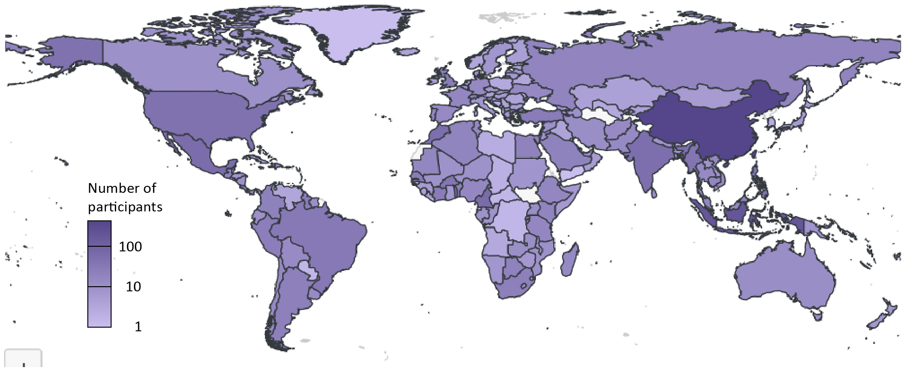
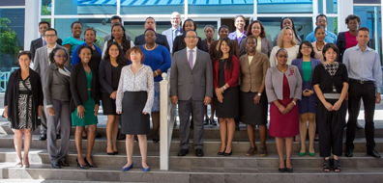
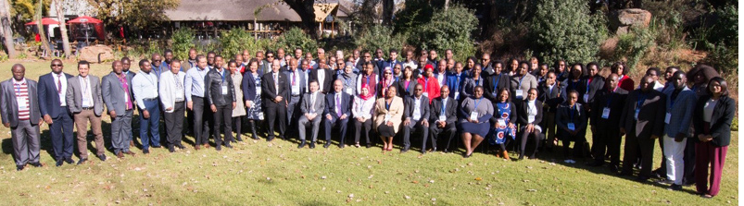
ITS e-learning around the world
Onno Hoffmeister, Technical assistance and capacity building trade in services statistics
Workshop on Integrated Use of International Trade Statistics and Economic Statistics, 23 Nov 2021

Slide 10
Distance learning as a tool for capacity building
Onno Hoffmeister, Technical assistance and capacity building trade in services statistics
Advantages | Challenges
No borders, no travel Low marginal costs Easy to fit to trainees’ daily routines (self-paced) Easy to adapt to different needs | Technical infrastructure Internet access, learning management system Social distance Flatter learning curve in single than group learning
Workshop on Integrated Use of International Trade Statistics and Economic Statistics, 23 Nov 2021

Slide 11
Main features of the programme
Onno Hoffmeister, Technical assistance and capacity building trade in services statistics
Facilitated training – not purely self-paced
Complementary face-to-face component – not only online
Training based on content – not on instructors
UNCTAD-UNSD-WTO collaboration
Building on Blended Learning initiative – not starting from zero
Embedded in the TrainForTrade programme
Workshop on Integrated Use of International Trade Statistics and Economic Statistics, 23 Nov 2021

Slide 12
Target group and training needs
Onno Hoffmeister, Technical assistance and capacity building trade in services statistics
Target group:
Primary: statistics compilers
Secondary: statistics users
Needs:
Enhanced knowledge of concepts and methods
Enhanced compilation skills
Guidance in solving compilation challenges
Workshop on Integrated Use of International Trade Statistics and Economic Statistics, 23 Nov 2021

Slide 13
Design of the course
Onno Hoffmeister, Technical assistance and capacity building trade in services statistics
One course in STIS, one course in IMTS
6 modules (1 week each)
Instruments
  Online lectures
  Manual
  Online forum
  Quizzes and tests
  Onsite workshops / webinars (during the pandemic)
Workshop on Integrated Use of International Trade Statistics and Economic Statistics, 23 Nov 2021

Slide 14
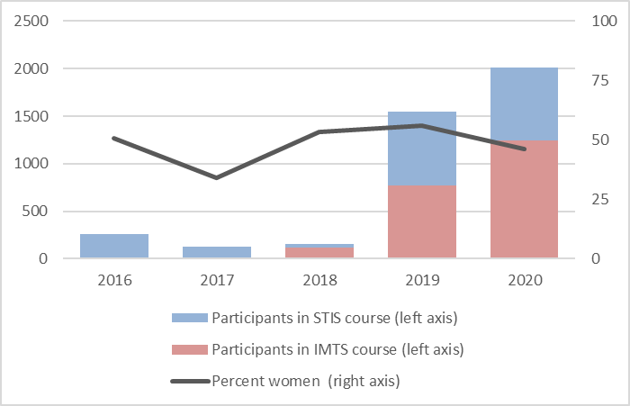
Number of persons trained
Onno Hoffmeister, Technical assistance and capacity building trade in services statistics
Workshop on Integrated Use of International Trade Statistics and Economic Statistics, 23 Nov 2021

Slide 15
Registrations by countries of residence
Onno Hoffmeister, Technical assistance and capacity building trade in services statistics
Workshop on Integrated Use of International Trade Statistics and Economic Statistics, 23 Nov 2021

Slide 16
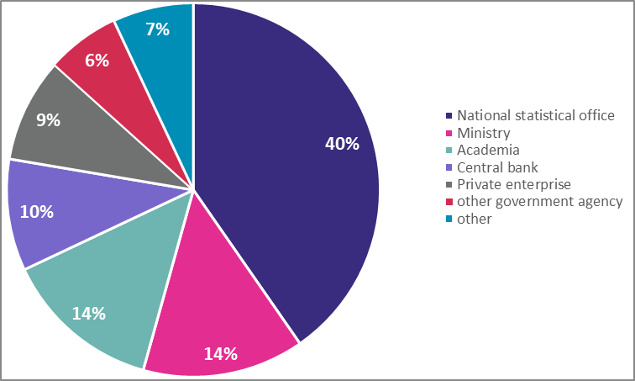
Registrations by work domain, 2020
Onno Hoffmeister, Technical assistance and capacity building trade in services statistics
Workshop on Integrated Use of International Trade Statistics and Economic Statistics, 23 Nov 2021

Slide 17
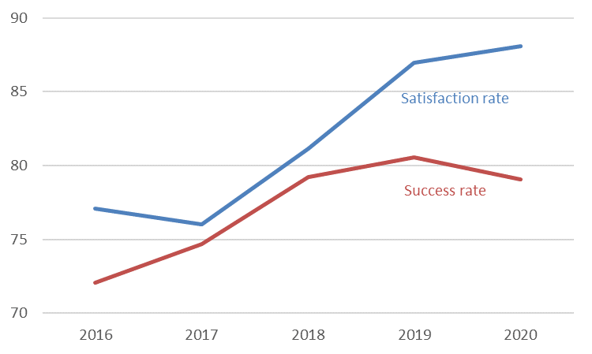
Success and satisfaction rate
Onno Hoffmeister, Technical assistance and capacity building trade in services statistics
Workshop on Integrated Use of International Trade Statistics and Economic Statistics, 23 Nov 2021

Slide 18
Taking stock
Onno Hoffmeister, Technical assistance and capacity building trade in services statistics
Number of participants growing
Coverage global and gender-balanced
Target group reached
Success rate stable at 80% for three years
Satisfaction rate steadily increasing (2020: 86%)
Low impact of COVID-19
Workshop on Integrated Use of International Trade Statistics and Economic Statistics, 23 Nov 2021

Slide 19
Further plans
Onno Hoffmeister, Technical assistance and capacity building trade in services statistics
Onsite workshops to resume after COVID-19
More interactivity in the lectures
New languages
New components
Workshop on Integrated Use of International Trade Statistics and Economic Statistics, 23 Nov 2021

Slide 20
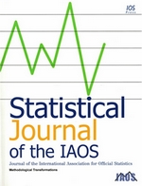
For more information …
Onno Hoffmeister, Technical assistance and capacity building trade in services statistics
UNCTAD Statistics website:
  https://unctad.org/statistics
TrainForTrade portal:
  https://tft.unctad.org/
Reports of ITS online training events on UNSD website:
  https://unstats.un.org/unsd/trade/events/
Hoffmeister, D’Andrea Adrian, Assaf, Barnat, Chantrel, Kulaga, Muryawan, 2021: Trade statistics capacity building beyond borders, Statistical Journal of the IAOS, 37, 997-1007
Workshop on Integrated Use of International Trade Statistics and Economic Statistics, 23 Nov 2021

